Slide 1
Merged Longest Common Subsequence Problems with t-length Substrings and at Least t-length Substrings
Student: Du-Cheng Wu (吳篤承)
Advisor: Prof. Chang-Biau Yang (楊昌彪)
Date: May 20, 2020

Slide 2
Longest Common Subsequence (LCS) Problem
A = tatagct, B = ataatcatc
Subsequence A’ of A：
A = tatagct ⟹ A’ = agc
Common subsequence of A and B：
A = tatagct
B = ataatcatc
CS(A, B) = tct
Longest common subsequence of A and B：
A = tatagct
B = ataatcatc
LCS(A, B)= tatac

Slide 3
Merged Longest Common Subsequence (MLCS) Problem
A = atc, B = cctg, P = acgtct
Merged sequence E(A,B)：
E₁(A,B) = a₁a₂b₁b₂a₃b₃b₄ = atccctg
E₂(A,B) = b₁a₁b₂a₂b₃a₃b₄ = cacttcg
E₃(A,B) = a₁b₁b₂a₂a₃b₃b₄ = acctctg
Merged longest common subsequence：
P = acgtct
E₃(A,B) = acctctg
LCS(E₃(A,B), P) = actct

Slide 4
Longest Common Subsequence with t-length Substrings (LCS_{t}) Problem
A = actagt, B = ctacggt, t = 2
Longest common subsequence with 2 length substrings LCS_{t} of A and B：
A = actagt
B = ctacggt
LCS_{t}(A,B) = acgt = A_{1..2} A_{5..6}= B_{3..4} B_{6..7}

Slide 5
Longest Common Subsequence with at Least t-length Substrings (LCS_{t+}) Problem
A = actagt, B = ctacggt, t = 2
Longest common subsequence with at least 2 length substrings LCS_{t+} of A and B：
A = actagt
B = ctacggt
LCS_{t+}(A,B) = ctagt = A_{2..4} A_{5..6}= B_{1..3} B_{6..7}

Slide 6
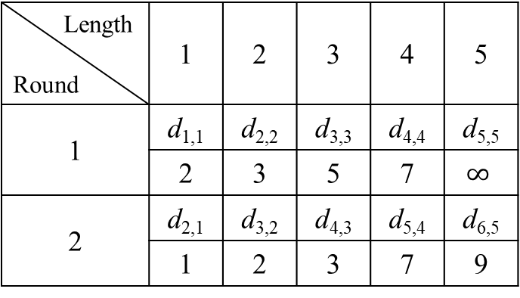
Nakatsu’s Diagonal LCS Algorithm
A = tatagct, B = ataatcatc
B A |  | 1 | 2 | 3 | 4 | 5 | 6 | 7 | 8 | 9
 |  | a | t | a | a | t | c | a | t | c
1 | t |  | 1
2 | a | 1 |  | 2
3 | t |  | 2 |  |  | 3
4 | a |  |  | 3 |  |  |  | 4
5 | g
6 | c |  |  |  |  |  |  |  |  | 5
7 | t
Length Round | 1 | 2 | 3 | 4 | 5
1 | d_{1,1} | d_{2,2} | d_{3,3} | d_{4,4} | d_{5,5}
 | 2 | 3 | 5 | 7 | $$∞$$
2 | d_{2,1} | d_{3,2} | d_{4,3} | d_{5,4} | d_{6,5}
 | 1 | 2 | 3 | 7 | 9

Slide 7
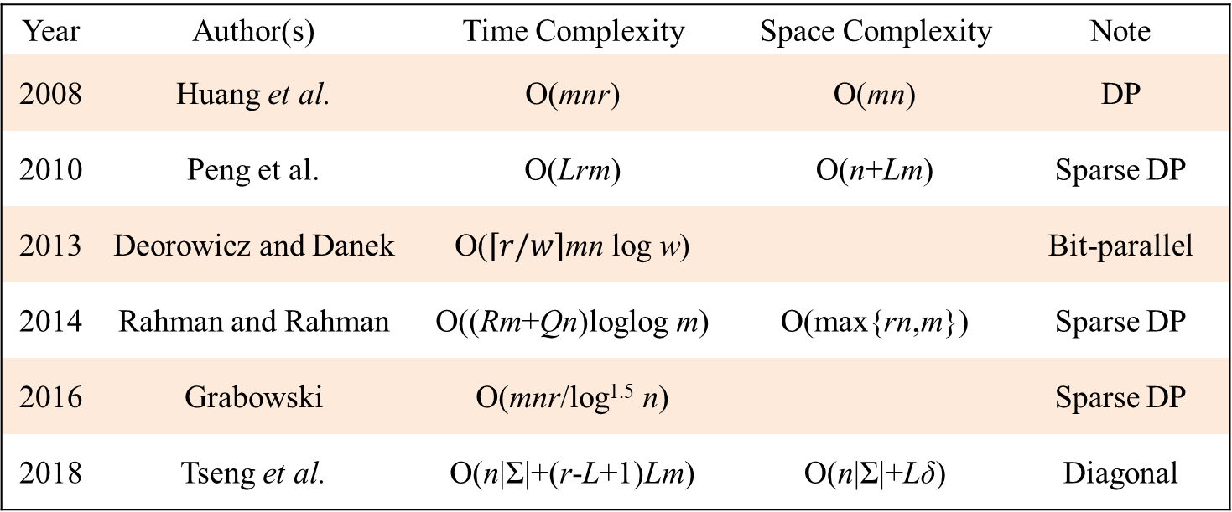
MLCS Algorithms
Year | Author(s) | Time Complexity | Space Complexity | Note
2008 | Huang et al. | O(mnr) | O(mn) | DP
2010 | Peng et al. | O(Lrm) | O(n+Lm) | Sparse DP
2013 | Deorowicz and Danek | O($\left\lceil r/w\right\rceil$mn log w) |  | Bit-parallel
2014 | Rahman and Rahman | O((Rm+Qn)loglog m) | O(max{rn,m}) | Sparse DP
2016 | Grabowski | O(mnr/log^{1.5} n) |  | Sparse DP
2018 | Tseng et al. | O(n|Σ|+(r-L+1)Lm) | O(n|Σ|+Lδ) | Diagonal
|A| = m, |B| = n, |P| = r; L: length of MLCS(A, B, P); Σ: alphabet set; w: word size of computer; R: number of total match pairs between A and P; Q: number of total match pairs between B and P; δ: max{A,B}

Slide 8
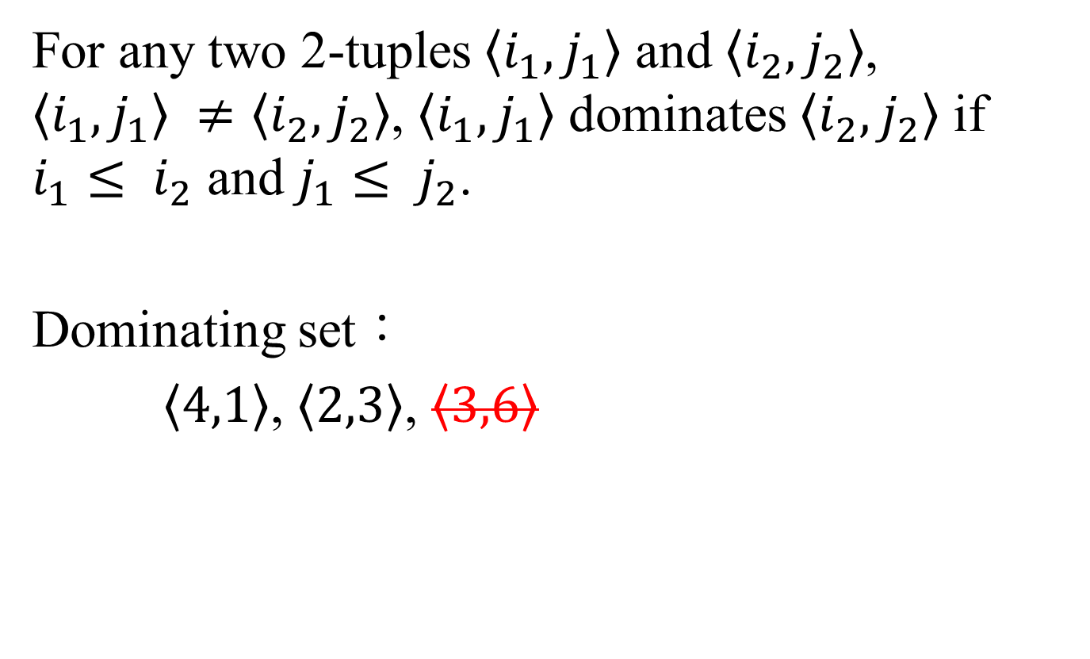
2-tuple and Dominating Set
For any two 2-tuples $\left\langle i_{1},j_{1}\right\rangle$ and $\left\langle i_{2},j_{2}\right\rangle$, $\left\langle i_{1},j_{1}\right\rangle ≠\left\langle i_{2},j_{2}\right\rangle$, $\left\langle i_{1},j_{1}\right\rangle$ dominates $\left\langle i_{2},j_{2}\right\rangle$ if $i_{1}≤ i_{2}$ and $j_{1}≤ j_{2}$.
Dominating set：
$\left\langle 4,1\right\rangle$, $\left\langle 2,3\right\rangle$, $\left\langle 3,6\right\rangle$

Slide 9
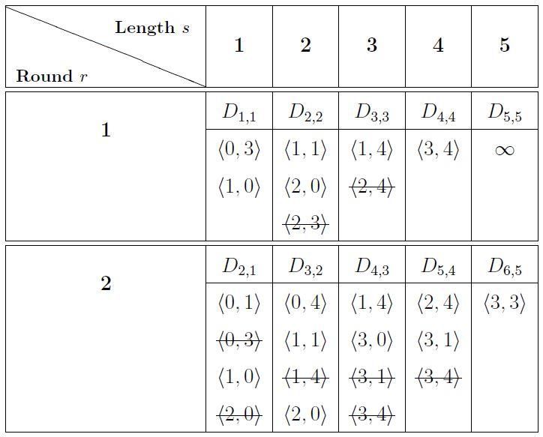
The MLCS Algorithm by Tseng et al.
A = ctg, B = ttca, P = ctagtc

Slide 10
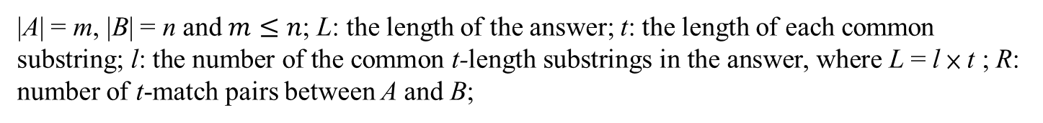
LCS_{t} Algorithms
Year | Author(s) | Time Complexity | Space Complexity | Note
2013 | Benson et al. | O(tmn) | O(tm) | DP
2014 | Deorowicz and Grabowski | DP: O(mn) Sparse: O(n + R log l) Dense: O(mn / t+ m ( t log n )^{2/3}) Dense-vEB: O(mn log log m / t) DP-4R: O(mn / log m) | DP: O(tm) Sparse: O(n + min{R,ml}) Dense: O(m) Dense-vEB: O(m log log m) DP-4R: O(n + nt / log n) | Sparse DP Van Emde Boas tree
2016 | Benson et al. | O(mn) | O(tm) | DP
2017 | Zhu et al. | O(mn) | O(tm) | Divide-and-conquer
2018 | Pavetić et al. | O(m + n + R + min{ R log l , R + ml}) | O(m+n) | Match pair
2020 | Huang et al. | O(n(m-L)) O(n+l(m-L)log n) O(n+l(m-L)+R) | O(n) | Diagonal
|A| = m, |B| = n and $m≤n$; L: the length of the answer; t: the length of each common substring; l: the number of the common t-length substrings in the answer, where L = l × t ; R: number of t-match pairs between A and B;

Slide 11
The LCS_{t} Algorithm by Benson et al.
A = actagt, B = ctacggt, t = 2
B A |  | 1 | 2 | 3 | 4 | 5 | 6 | 7
 |  | c | t | a | c | g | g | t
1 | a | 0 | 0 | 0 | 0 | 0 | 0 | 0
2 | c | 0 | 0 | 0 | 1 | 0 | 0 | 0
3 | t | 0 | 1 | 0 | 0 | 0 | 0 | 0
4 | a | 0 | 0 | 1 | 0 | 0 | 0 | 0
5 | g | 0 | 0 | 0 | 0 | 0 | 0 | 0
6 | t | 0 | 0 | 0 | 0 | 0 | 0 | 1
$$tMatch(i,j)= \left\{\begin{aligned}1 if a_{i−f}= b_{j−f}, for every 0≤f≤t−1 \\ 0 otherwise \end{aligned}\right.$$

Slide 12
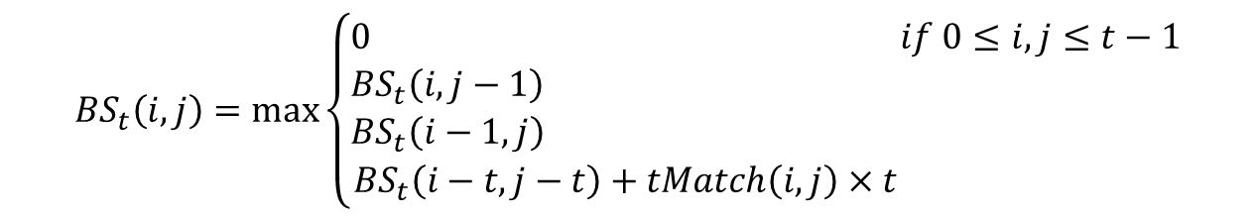
The LCS_{t} Algorithm by Benson et al.
A = actagt, B = ctacggt, t = 2
B A |  | 1 | 2 | 3 | 4 | 5 | 6 | 7
 |  | c | t | a | c | g | g | t
1 | a | 0 | 0 | 0 | 0 | 0 | 0 | 0
2 | c | 0 | 0 | 0 | 2 | 2 | 2 | 2
3 | t | 0 | 2 | 2 | 2 | 2 | 2 | 2
4 | a | 0 | 2 | 2 | 2 | 2 | 2 | 2
5 | g | 0 | 2 | 2 | 2 | 2 | 2 | 2
6 | t | 0 | 2 | 2 | 2 | 2 | 2 | 4
Solution: acgt
Length: 4
Time complexity: O(tmn)
$${BS}_{t}\left(i,j\right)=max\left\{\begin{aligned}0 if 0≤i,j≤t−1 \\ {BS}_{t}\left(i,j−1\right) \\ {BS}_{t}\left(i−1,j\right) \\ {BS}_{t}\left(i−t,j−t\right)+tMatch\left(i,j\right)×t \end{aligned}\right.$$

Slide 13
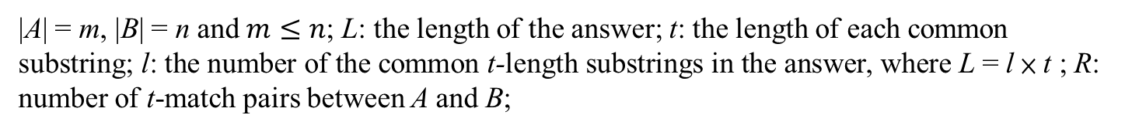
LCS_{t+} Algorithms
Year | Author(s) | Time Complexity | Space Complexity | Note
2014 | Pavetić et al. | O(m + n + R log R) | O(m + n + R) | Sparse DP
2016 | Benson et al. | O(tmn) | O(tm) | DP
2017 | Ueki et al. | O(mn) | O(tm), n > m | DP
2017 | Zhu et al. | O(mn) | O(tm) | Divide-and-conquer
2018 | Pavetić et al. | O(m + n + R + min{ R (log L + t) , R + mL}) | O(m+n) | Match pair
2020 | Huang et al. | O(n+L(m-L)+R) | O(R) | Diagonal
|A| = m, |B| = n and $m≤n$; L: the length of the answer; t: the length of each common substring; l: the number of the common t-length substrings in the answer, where L = l × t ; R: number of t-match pairs between A and B;

Slide 14
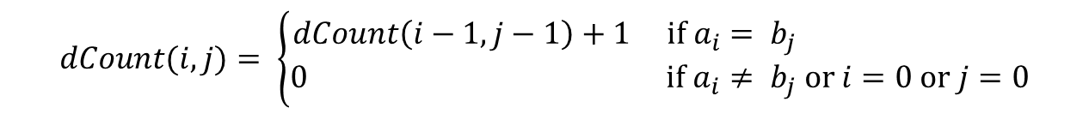
The LCS_{t+} Algorithm by Benson et al.
A = actagt, B = ctacggt, t = 2
B A |  | 1 | 2 | 3 | 4 | 5 | 6 | 7
 |  | c | t | a | c | g | g | t
1 | a | 0 | 0 | 1 | 0 | 0 | 0 | 0
2 | c | 1 | 0 | 0 | 2 | 0 | 0 | 0
3 | t | 0 | 2 | 0 | 0 | 0 | 0 | 1
4 | a | 0 | 0 | 3 | 0 | 0 | 0 | 0
5 | g | 0 | 0 | 0 | 0 | 1 | 1 | 0
6 | t | 0 | 1 | 0 | 0 | 0 | 0 | 2
$$dCount(i,j)= \left\{\begin{aligned}dCount\left(i−1,j−1\right)+1 if a_{i}= b_{j} \\ 0 if a_{i}≠ b_{j} or i=0 or j=0\end{aligned}\right.$$

Slide 15
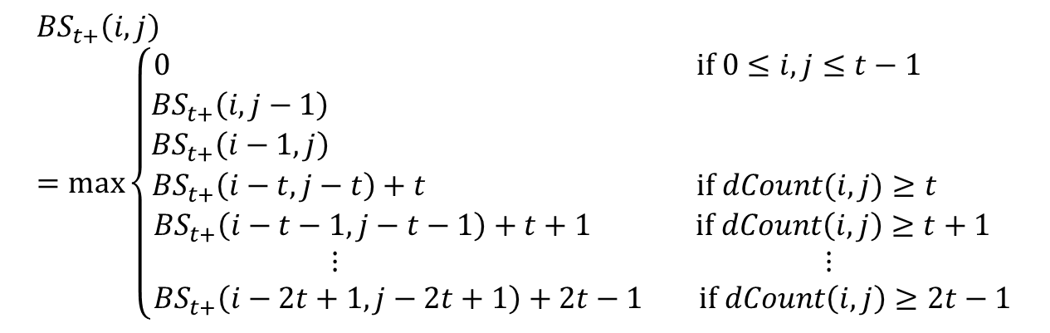
The LCS_{t+} Algorithm by Benson et al.
A = actagt, B = ctacggt, t = 2
B A |  | 1 | 2 | 3 | 4 | 5 | 6 | 7
 |  | c | t | a | c | g | g | t
1 | a | 0 | 0 | 0 | 0 | 0 | 0 | 0
2 | c | 0 | 0 | 0 | 2 | 2 | 2 | 2
3 | t | 0 | 2 | 2 | 2 | 2 | 2 | 2
4 | a | 0 | 2 | 3 | 3 | 3 | 3 | 3
5 | g | 0 | 2 | 3 | 3 | 3 | 3 | 3
6 | t | 0 | 2 | 3 | 3 | 3 | 3 | 5
Solution: ctagt
Length: 5
Time complexity: O(tmn)
$${BS}_{t+}\left(i,j\right)=max\left\{\begin{aligned}0 if 0≤i,j≤t−1 \\ {BS}_{t+}\left(i,j−1\right) \\ {BS}_{t+}\left(i−1,j\right) \\ {BS}_{t+}\left(i−t,j−t\right)+t if dCount(i,j)≥t \\ {BS}_{t+}\left(i−t−1,j−t−1\right)+t+1 if dCount\left(i,j\right)≥t+1 \\ ⋮ ⋮ \\ {BS}_{t+}\left(i−2t+1,j−2t+1\right)+2t−1 if dCount\left(i,j\right)≥2t−1\end{aligned}\right.$$

Slide 16
Merged Longest Common Subsequence Problems with t-length Substrings(MLCS_{t}) and at Least t-length Substrings(MLCS_{t+})
A = atcag, B = tcgta, P = atctacag, t = 2
MLCS(A,B,P) = atctacag
MLCS_{t}(A,B,P) = attaca
MLCS_{t+}(A,B,P) = attacag

Slide 17
Merged Longest Common Subsequence Problems with t-length Substrings(MLCS_{t}) and at Least t-length Substrings(MLCS_{t+})
A = atcag, B = tcgta, P = atctacag, t = 2
MLCS(A,B,P) = atctacag
MLCS_{t}(A,B,P) = attaca
MLCS_{t+}(A,B,P) = attacag

Slide 18
Merged Longest Common Subsequence Problems with t-length Substrings(MLCS_{t}) and at Least t-length Substrings(MLCS_{t+})
A = atcag, B = tcgta, P = atctacag, t = 2
MLCS(A,B,P) = atctacag
MLCS_{t}(A,B,P) = attaca
MLCS_{t+}(A,B,P) = attacag

Slide 19
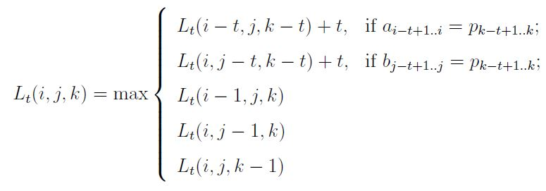
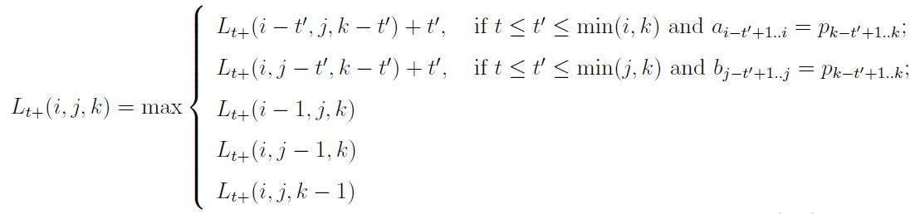
DP Algorithm for MLCS_{t} and MLCS_{t+}
time complexity: O(mnr)
time complexity: O(mnrt)

Slide 20
Diagonal Algorithm for MLCS_{t}
A = abcab, B = bcbba, P = abcbbcab, t = 2
Length Round | 0 | 2 | 4 | 6
1 | d_{0,0} | d_{2,2} | d_{4,4} | d_{6,6}
 | (0,0) | (2,0)
2 | d_{1,0} | d_{3,2} | d_{5,4} | d_{7,6}

Slide 21
Diagonal Algorithm for MLCS_{t}
A = abcab, B = bcbba, P = abcbbcab, t = 2
Length Round | 0 | 2 | 4 | 6
1 | d_{0,0} | d_{2,2} | d_{4,4} | d_{6,6}
 | (0,0) | (2,0) | (2,3)
2 | d_{1,0} | d_{3,2} | d_{5,4} | d_{7,6}

Slide 22
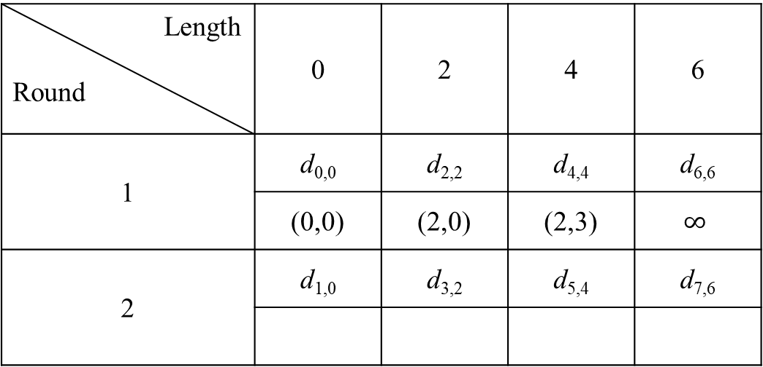
Diagonal Algorithm for MLCS_{t}
A = abcab, B = bcbba, P = abcbbcab, t = 2
Length Round | 0 | 2 | 4 | 6
1 | d_{0,0} | d_{2,2} | d_{4,4} | d_{6,6}
 | (0,0) | (2,0) | (2,3) | $$∞$$
2 | d_{1,0} | d_{3,2} | d_{5,4} | d_{7,6}

Slide 23
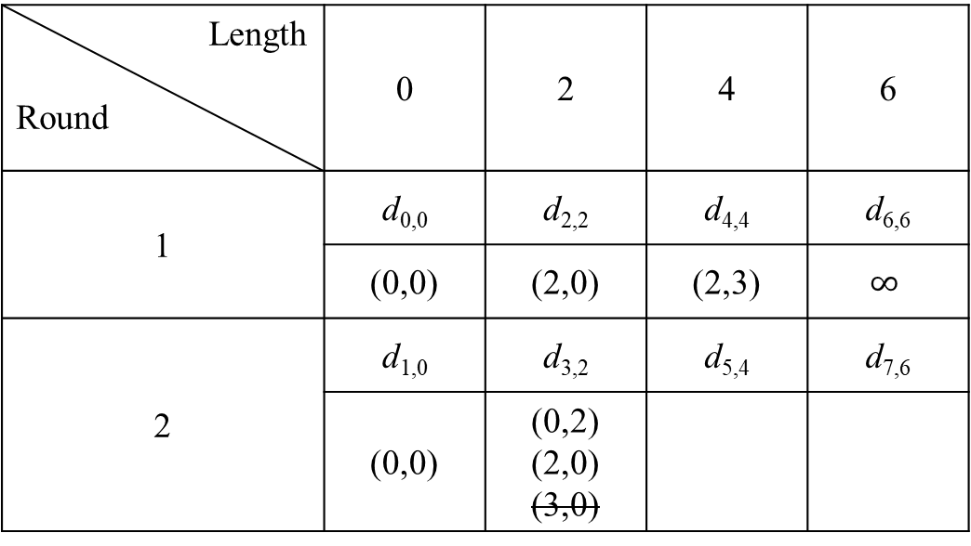
Diagonal Algorithm for MLCS_{t}
A = abcab, B = bcbba, P = abcbbcab, t = 2
Length Round | 0 | 2 | 4 | 6
1 | d_{0,0} | d_{2,2} | d_{4,4} | d_{6,6}
 | (0,0) | (2,0) | (2,3) | $$∞$$
2 | d_{1,0} | d_{3,2} | d_{5,4} | d_{7,6}
 | (0,0) | (0,2) (2,0) (3,0)

Slide 24
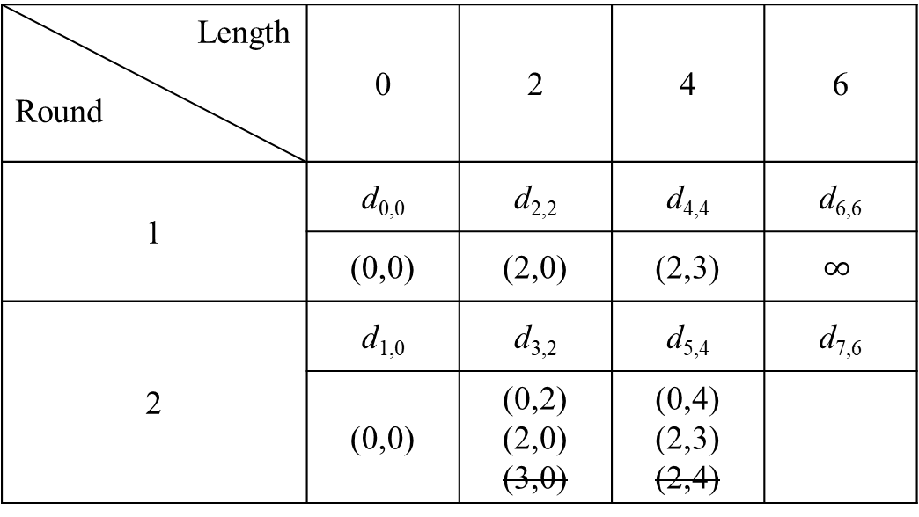
Diagonal Algorithm for MLCS_{t}
A = abcab, B = bcbba, P = abcbbcab, t = 2
Length Round | 0 | 2 | 4 | 6
1 | d_{0,0} | d_{2,2} | d_{4,4} | d_{6,6}
 | (0,0) | (2,0) | (2,3) | $$∞$$
2 | d_{1,0} | d_{3,2} | d_{5,4} | d_{7,6}
 | (0,0) | (0,2) (2,0) (3,0) | (0,4) (2,3) (2,4)

Slide 25
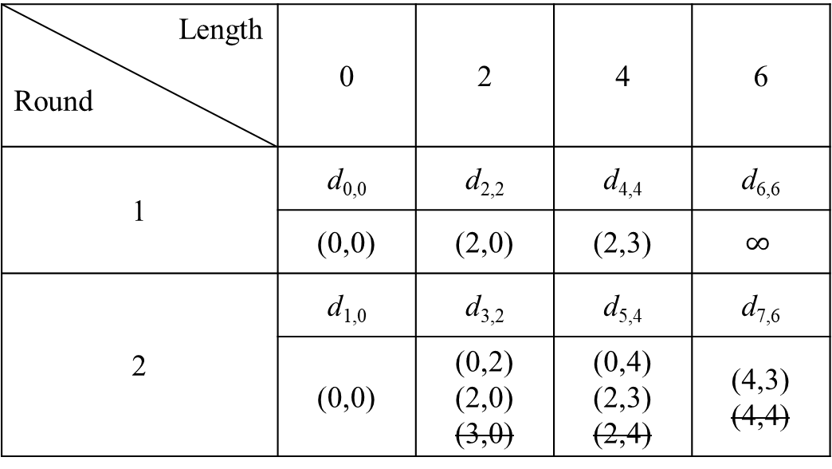
Diagonal Algorithm for MLCS_{t}
A = abcab, B = bcbba, P = abcbbcab, t = 2
Length Round | 0 | 2 | 4 | 6
1 | d_{0,0} | d_{2,2} | d_{4,4} | d_{6,6}
 | (0,0) | (2,0) | (2,3) | $$∞$$
2 | d_{1,0} | d_{3,2} | d_{5,4} | d_{7,6}
 | (0,0) | (0,2) (2,0) (3,0) | (0,4) (2,3) (2,4) | (4,3) (4,4)

Slide 26
Diagonal Algorithm for MLCS_{t+}
A = abcabcbccbcabb, B = cabcabccacab, P = abccabbacabcac, t = 3
A P |  | 1 | 2 | 3 | 4 | 5 | 6 | 7 | 8 | 9 | 10 | 11 | 12 | 13 | 14
 |  | a | b | c | a | b | c | b | c | c | b | c | a | b | b
1 | a | 1 |  |  | 1 |  |  |  |  |  |  |  | 1
2 | b |  | 2 |  |  | 2 |  | 1 |  |  | 1 |  |  | 2 | 1
3 | c |  |  | 3 |  |  | 3 |  | 2 | 1 |  | 2
4 | c |  |  | 1 |  |  | 1 |  | 1 | 3 |  | 1
5 | a | 1 |  |  | 2 |  |  |  |  |  |  |  | 2
6 | b |  | 2 |  |  | 3 |  | 1 |  |  | 1 |  |  | 3 | 1
7 | b |  | 1 |  |  | 1 |  | 1 |  |  | 1 |  |  | 1 | 4
8 | a | 1 |  |  | 1 |  |  |  |  |  |  |  | 1
match [3]: A$\left\langle 3,6\right\rangle$
match [4]: A$\left\langle 9\right\rangle$
match [5]:
match [6]: A$\left\langle 5,13\right\rangle$
match [7]: A$\left\langle 14\right\rangle$

Slide 27
Diagonal Algorithm for MLCS_{t+}
A = abcabcbccbcabb, B = cabcabccacab, P = abccabbacabcac, t = 3
B P |  | 1 | 2 | 3 | 4 | 5 | 6 | 7 | 8 | 9 | 10 | 11 | 12
 |  | c | a | b | c | a | b | c | c | a | c | a | b
1 | a |  | 1 |  |  | 1 |  |  |  | 1 |  | 1
2 | b |  |  | 2 |  |  | 2 |  |  |  |  |  | 2
3 | c | 1 |  |  | 3 |  |  | 3 | 1 |  | 1
4 | c | 1 |  |  | 1 |  |  | 1 | 4 |  | 1
5 | a |  | 2 |  |  | 2 |  |  |  | 5 |  | 2
6 | b |  |  | 3 |  |  | 3 |  |  |  |  |  | 3
7 | b |  |  | 1 |  |  | 1 |  |  |  |  |  | 1
8 | a |  | 1 |  |  | 1 |  |  |  | 1 |  | 1
match [3]: B$\left\langle 4,7\right\rangle$
match [4]: B$\left\langle 8\right\rangle$
match [5]: B$\left\langle 9\right\rangle$
match [6]: B$\left\langle 3,6,12\right\rangle$
match [7]:

Slide 28
Diagonal Algorithm for MLCS_{t+}
match [3]: A$\left\langle 3,6\right\rangle$, B$\left\langle 4,7\right\rangle$
match [4]: A$\left\langle 9\right\rangle$, B$\left\langle 8\right\rangle$
match [5]: B$\left\langle 9\right\rangle$
match [6]: A$\left\langle 5,13\right\rangle$, B$\left\langle 3,6,12\right\rangle$
match [7]: A$\left\langle 14\right\rangle$
A = abcabcbccbcabb
B = cabcabccacab
P = abccabbacabcac
t = 3
Length Round | 0 | 1 | 2 | 3 | 4 | 5 | 6 | 7 | 8
1 | d_{0,0} | d_{1,1} | d_{2,2} | d_{3,3} | d_{4,4} | d_{5,5} | d_{6,6} | d_{7,7} | d_{8,8}
 | (0,0) | $$∞$$ | $$∞$$ | (0,4) (3,0)

Slide 29
Diagonal Algorithm for MLCS_{t+}
match [3]: A$\left\langle 3,6\right\rangle$, B$\left\langle 4,7\right\rangle$
match [4]: A$\left\langle 9\right\rangle$, B$\left\langle 8\right\rangle$
match [5]: B$\left\langle 9\right\rangle$
match [6]: A$\left\langle 5,13\right\rangle$, B$\left\langle 3,6,12\right\rangle$
match [7]: A$\left\langle 14\right\rangle$
A = abcabcbccbcabb
B = cabcabccacab
P = abccabbacabcac
t = 3
Length Round | 0 | 1 | 2 | 3 | 4 | 5 | 6 | 7 | 8
1 | d_{0,0} | d_{1,1} | d_{2,2} | d_{3,3} | d_{4,4} | d_{5,5} | d_{6,6} | d_{7,7} | d_{8,8}
 | (0,0) | $$∞$$ | $$∞$$ | (0,4) (3,0) | (0,8)

Slide 30
Diagonal Algorithm for MLCS_{t+}
match [3]: A$\left\langle 3,6\right\rangle$, B$\left\langle 4,7\right\rangle$
match [4]: A$\left\langle 9\right\rangle$, B$\left\langle 8\right\rangle$
match [5]: B$\left\langle 9\right\rangle$
match [6]: A$\left\langle 5,13\right\rangle$, B$\left\langle 3,6,12\right\rangle$
match [7]: A$\left\langle 14\right\rangle$
A = abcabcbccbcabb
B = cabcabccacab
P = abccabbacabcac
t = 3
Length Round | 0 | 1 | 2 | 3 | 4 | 5 | 6 | 7 | 8
1 | d_{0,0} | d_{1,1} | d_{2,2} | d_{3,3} | d_{4,4} | d_{5,5} | d_{6,6} | d_{7,7} | d_{8,8}
 | (0,0) | $$∞$$ | $$∞$$ | (0,4) (3,0) | (0,8) | (0,9)

Slide 31
Diagonal Algorithm for MLCS_{t+}
match [3]: A$\left\langle 3,6\right\rangle$, B$\left\langle 4,7\right\rangle$
match [4]: A$\left\langle 9\right\rangle$, B$\left\langle 8\right\rangle$
match [5]: B$\left\langle 9\right\rangle$
match [6]: A$\left\langle 5,13\right\rangle$, B$\left\langle 3,6,12\right\rangle$
match [7]: A$\left\langle 14\right\rangle$
A = abcabcbccbcabb
B = cabcabccacab
P = abccabbacabcac
t = 3
Length Round | 0 | 1 | 2 | 3 | 4 | 5 | 6 | 7 | 8
1 | d_{0,0} | d_{1,1} | d_{2,2} | d_{3,3} | d_{4,4} | d_{5,5} | d_{6,6} | d_{7,7} | d_{8,8}
 | (0,0) | $$∞$$ | $$∞$$ | (0,4) (3,0) | (0,8) | (0,9) | (0,12) (5,4) (3,3) (13,0)

Slide 32
Diagonal Algorithm for MLCS_{t+}
match [3]: A$\left\langle 3,6\right\rangle$, B$\left\langle 4,7\right\rangle$
match [4]: A$\left\langle 9\right\rangle$, B$\left\langle 8\right\rangle$
match [5]: B$\left\langle 9\right\rangle$
match [6]: A$\left\langle 5,13\right\rangle$, B$\left\langle 3,6,12\right\rangle$
match [7]: A$\left\langle 14\right\rangle$
A = abcabcbccbcabb
B = cabcabccacab
P = abccabbacabcac
t = 3
Length Round | 0 | 1 | 2 | 3 | 4 | 5 | 6 | 7 | 8
1 | d_{0,0} | d_{1,1} | d_{2,2} | d_{3,3} | d_{4,4} | d_{5,5} | d_{6,6} | d_{7,7} | d_{8,8}
 | (0,0) | $$∞$$ | $$∞$$ | (0,4) (3,0) | (0,8) | (0,9) | (0,12) (5,4) (3,3) (13,0) | (14,8) (14,4)

Slide 33
Diagonal Algorithm for MLCS_{t+}
match [3]: A$\left\langle 3,6\right\rangle$, B$\left\langle 4,7\right\rangle$
match [4]: A$\left\langle 9\right\rangle$, B$\left\langle 8\right\rangle$
match [5]: B$\left\langle 9\right\rangle$
match [6]: A$\left\langle 5,13\right\rangle$, B$\left\langle 3,6,12\right\rangle$
match [7]: A$\left\langle 14\right\rangle$
A = abcabcbccbcabb
B = cabcabccacab
P = abccabbacabcac
t = 3
Length Round | 0 | 1 | 2 | 3 | 4 | 5 | 6 | 7 | 8
1 | d_{0,0} | d_{1,1} | d_{2,2} | d_{3,3} | d_{4,4} | d_{5,5} | d_{6,6} | d_{7,7} | d_{8,8}
 | (0,0) | $$∞$$ | $$∞$$ | (0,4) (3,0) | (0,8) | (0,9) | (0,12) (5,4) (3,3) (13,0) | (14,8) (14,4) | $$∞$$

Slide 34
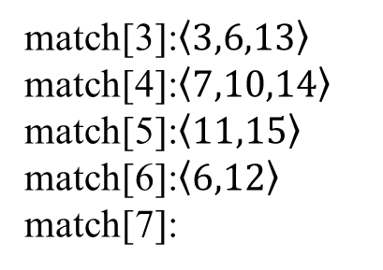
Diagonal Algorithm for MLCS_{t+}
A = abcabccbccabcca, B = cabbcabccacab, P = abccabbacabcac, t = 3
A P |  | 1 | 2 | 3 | 4 | 5 | 6 | 7 | 8 | 9 | 10 | 11 | 12 | 13 | 14 | 15
 |  | a | b | c | a | b | c | c | b | c | c | a | b | c | c | a
1 | a | 1 |  |  | 1 |  |  |  |  |  |  | 1 |  |  |  | 1
2 | b |  | 2 |  |  | 2 |  |  | 1 |  |  |  | 2
3 | c |  |  | 3 |  |  | 3 | 1 |  | 2 | 1 |  |  | 3 | 1
4 | c |  |  | 1 |  |  | 1 | 4 |  | 1 | 3 |  |  | 1 | 4
5 | a | 1 |  |  | 2 |  |  |  |  |  |  | 4 |  |  |  | 5
6 | b |  | 2 |  |  | 3 |  |  | 1 |  |  |  | 5
7 | b |  | 1 |  |  | 1 |  |  | 1 |  |  |  | 1
8 | a | 1 |  |  | 1 |  |  |  |  |  |  | 1 |  |  |  | 1
match[3]:$\left\langle 3,6,13\right\rangle$
match[4]:$\left\langle 7,10,14\right\rangle$
match[5]:$\left\langle 11,15\right\rangle$
match[6]:$\left\langle 6,12\right\rangle$
match[7]:

Slide 35
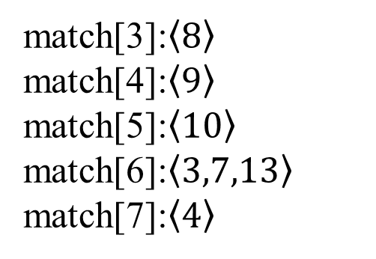
Diagonal Algorithm for MLCS_{t+}
A = abcabccbccabcca, B = cabbcabccacab, P = abccabbacabcac, t = 3
B P |  | 1 | 2 | 3 | 4 | 5 | 6 | 7 | 8 | 9 | 10 | 11 | 12 | 13
 |  | c | a | b | b | c | a | b | c | c | a | c | a | b
1 | a |  | 1 |  |  |  | 1 |  |  |  | 1 |  | 1
2 | b |  |  | 2 | 1 |  |  | 2 |  |  |  |  |  | 2
3 | c | 1 |  |  |  | 2 |  |  | 3 | 1 |  | 1
4 | c | 1 |  |  |  | 1 |  |  | 1 | 4 |  | 1
5 | a |  | 2 |  |  |  | 2 |  |  |  | 5 |  | 2
6 | b |  |  | 3 | 1 |  |  | 3 |  |  |  |  |  | 3
7 | b |  |  | 1 | 4 |  |  | 1 |  |  |  |  |  | 1
8 | a |  | 1 |  |  |  | 1 |  |  |  | 1 |  | 1
match[3]:$\left\langle 8\right\rangle$
match[4]:$\left\langle 9\right\rangle$
match[5]:$\left\langle 10\right\rangle$
match[6]:$\left\langle 3,7,13\right\rangle$
match[7]:$\left\langle 4\right\rangle$

Slide 36
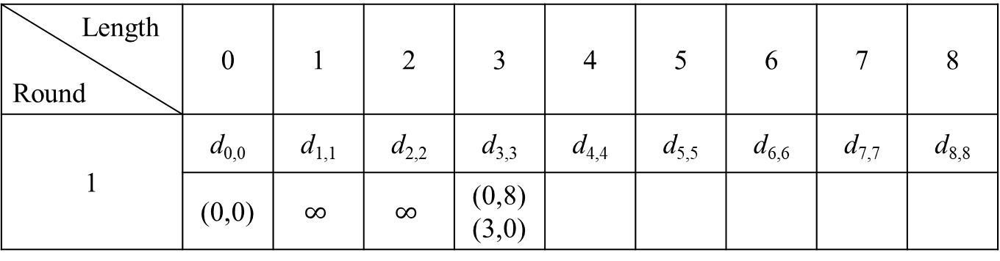
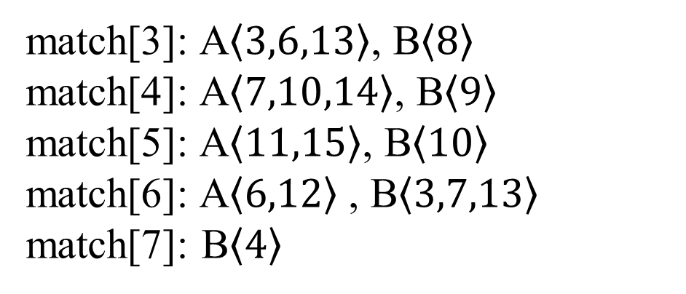
Diagonal Algorithm for MLCS_{t+}
match[3]: A$\left\langle 3,6,13\right\rangle$, B$\left\langle 8\right\rangle$
match[4]: A$\left\langle 7,10,14\right\rangle$, B$\left\langle 9\right\rangle$
match[5]: A$\left\langle 11,15\right\rangle$, B$\left\langle 10\right\rangle$
match[6]: A$\left\langle 6,12\right\rangle$, B$\left\langle 3,7,13\right\rangle$
match[7]: B$\left\langle 4\right\rangle$
A = abcabccbccabcca
B = cabbcabccacab
P = abccabbacabcac
t = 3
Length Round | 0 | 1 | 2 | 3 | 4 | 5 | 6 | 7 | 8
1 | d_{0,0} | d_{1,1} | d_{2,2} | d_{3,3} | d_{4,4} | d_{5,5} | d_{6,6} | d_{7,7} | d_{8,8}
 | (0,0) | $$∞$$ | $$∞$$ | (0,8) (3,0)

Slide 37
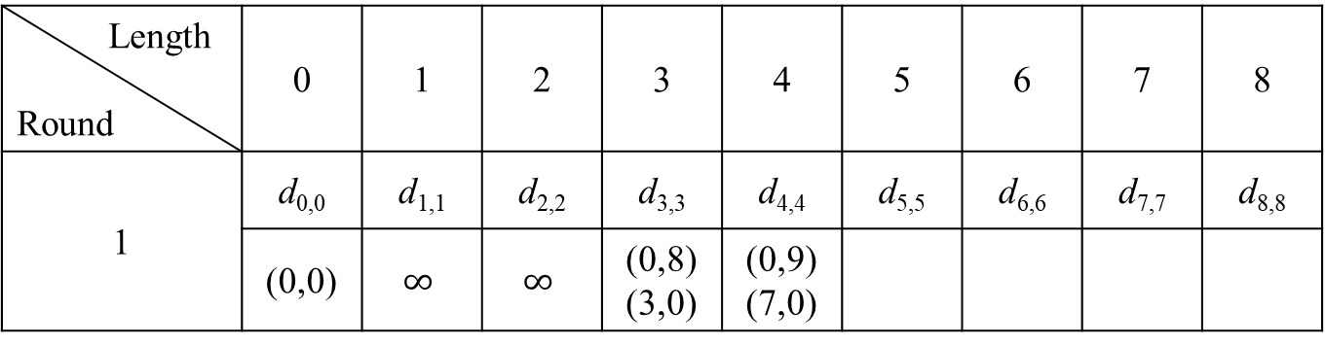
Diagonal Algorithm for MLCS_{t+}
match[3]: A$\left\langle 3,6,13\right\rangle$, B$\left\langle 8\right\rangle$
match[4]: A$\left\langle 7,10,14\right\rangle$, B$\left\langle 9\right\rangle$
match[5]: A$\left\langle 11,15\right\rangle$, B$\left\langle 10\right\rangle$
match[6]: A$\left\langle 6,12\right\rangle$, B$\left\langle 3,7,13\right\rangle$
match[7]: B$\left\langle 4\right\rangle$
A = abcabccbccabcca
B = cabbcabccacab
P = abccabbacabcac
t = 3
Length Round | 0 | 1 | 2 | 3 | 4 | 5 | 6 | 7 | 8
1 | d_{0,0} | d_{1,1} | d_{2,2} | d_{3,3} | d_{4,4} | d_{5,5} | d_{6,6} | d_{7,7} | d_{8,8}
 | (0,0) | $$∞$$ | $$∞$$ | (0,8) (3,0) | (0,9) (7,0)

Slide 38
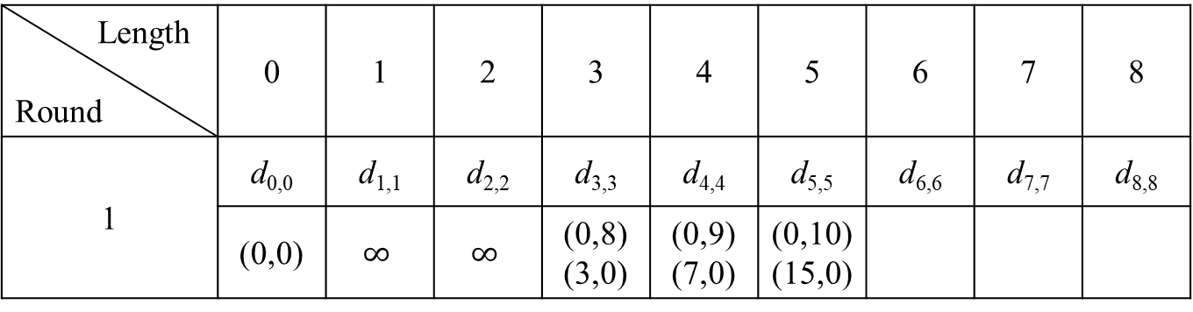
Diagonal Algorithm for MLCS_{t+}
match[3]: A$\left\langle 3,6,13\right\rangle$, B$\left\langle 8\right\rangle$
match[4]: A$\left\langle 7,10,14\right\rangle$, B$\left\langle 9\right\rangle$
match[5]: A$\left\langle 11,15\right\rangle$, B$\left\langle 10\right\rangle$
match[6]: A$\left\langle 6,12\right\rangle$, B$\left\langle 3,7,13\right\rangle$
match[7]: B$\left\langle 4\right\rangle$
A = abcabccbccabcca
B = cabbcabccacab
P = abccabbacabcac
t = 3
Length Round | 0 | 1 | 2 | 3 | 4 | 5 | 6 | 7 | 8
1 | d_{0,0} | d_{1,1} | d_{2,2} | d_{3,3} | d_{4,4} | d_{5,5} | d_{6,6} | d_{7,7} | d_{8,8}
 | (0,0) | $$∞$$ | $$∞$$ | (0,8) (3,0) | (0,9) (7,0) | (0,10) (15,0)

Slide 39
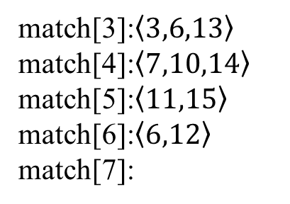
Diagonal Algorithm for MLCS_{t+}
A P |  | 1 | 2 | 3 | 4 | 5 | 6 | 7 | 8 | 9 | 10 | 11 | 12 | 13 | 14 | 15
 |  | a | b | c | a | b | c | c | b | c | c | a | b | c | c | a
1 | a | 1 |  |  | 1 |  |  |  |  |  |  | 1 |  |  |  | 1
2 | b |  | 2 |  |  | 2 |  |  | 1 |  |  |  | 2
3 | c |  |  | 3 |  |  | 3 | 1 |  | 2 | 1 |  |  | 3 | 1
4 | c |  |  | 1 |  |  | 1 | 4 |  | 1 | 3 |  |  | 1 | 4
5 | a | 1 |  |  | 2 |  |  |  |  |  |  | 4 |  |  |  | 5
6 | b |  | 2 |  |  | 3 |  |  | 1 |  |  |  | 5
7 | b |  | 1 |  |  | 1 |  |  | 1 |  |  |  | 1
8 | a | 1 |  |  | 1 |  |  |  |  |  |  | 1 |  |  |  | 1
match[3]:$\left\langle 3,6,13\right\rangle$
match[4]:$\left\langle 7,10,14\right\rangle$
match[5]:$\left\langle 11,15\right\rangle$
match[6]:$\left\langle 6,12\right\rangle$
match[7]:
m3 | 3 | 6 | 13
1 | 7 | 7 | 14
2 | -1 | -1 | -1
m4 | 7 | 10 | 14
1 | 11 | 11 | 15
2 | 15 | -1 | 15
m5 | 11 | 15
1 | 12 | -1
2 | -1 | -1

Slide 40

Time complexity
MLCS_{t} : O(preprocessing$+(r−L+1)Lm$)
MLCS_{t+} : O(preprocessing$+(r−L+1)Lm$)

Slide 41
Thanks for your listening.

